Slide 1

DevOps – GIT

Slide 2
Agenda:
What is Version Control System?
Central VCS and Distributed VCS
What is GIT?
Core Concepts of GIT
GIT Commands
Branching and Merging in GIT
GITHUB

Slide 3
What is Version control system?
What is version control system?
Version control is a system that records changes to a file or set of files over time so that you can recall specific versions later.
Benefits of Version Control System
Allows multiple people to work on same file
Track changes and also the author of the changes made to files (Versioning)
Helps in avoiding accidental changes and deletion
Saves Disk space and back-up
Collaboration and Teamwork
Comparing / Undo Changes
Code Review

Slide 4
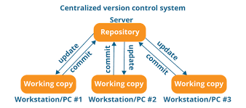
Centralized Version Control System
What is centralized version control system?
CVCS uses central server to store files
It works on a single repository where user can access the files directly
Central server could be local or remote machine directly connected to software engineer’s machine
Disadvantages:
Central repository is not available locally
Central Server crashes and will lose the data

Slide 5
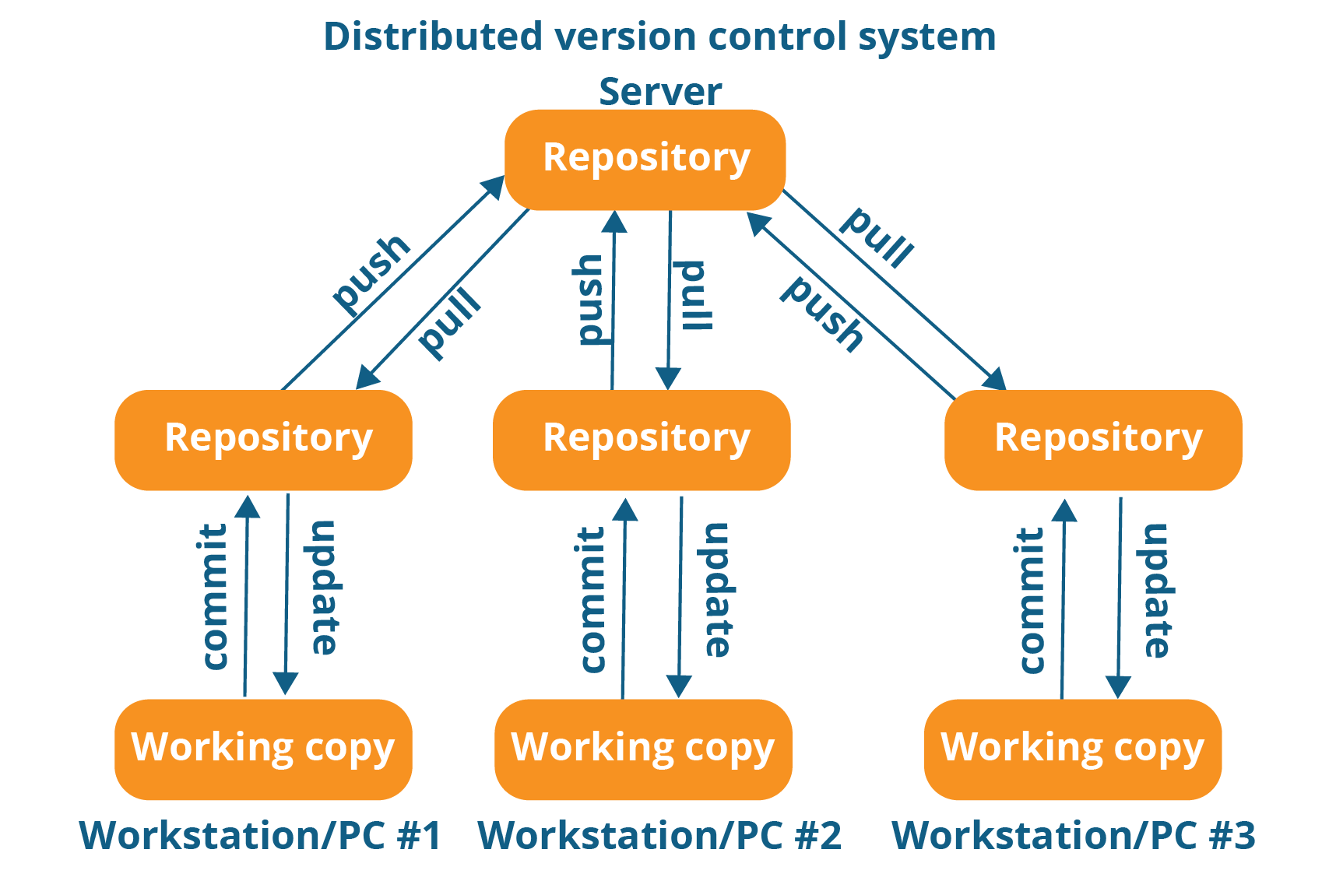
Distributed Version Control System
What is distributed version control system?
Every contributor have a local copy or “clone” of the main repo
Engineers can update their local repo with changes using ”pull” and “push” commands

Slide 6
What is GIT and GITHUB?
What is GIT and GITHUB?
Git is a revision control system, a tool to manage your source code history. GitHub is a hosting service for Git repositories. So they are not the same thing: Git is the tool, GitHub is the service for projects that use Git
Who use Source Control?
Software Engineers / Developers/ Programmers
Freelancers
Web Designers
Graphic Designers

Slide 7
Three Stages of GIT
Three Stages of GIT
Working Directory
Staging Area – Pre Commit
Commit – GIT Repository (history)
Remote Repository (GitHub)

Slide 8
GIT Installation
GIT Installation
Windows Installation Instructions:
https://www.youtube.com/watch?v=albr1o7Z1nw
Mac Installation:
https://www.youtube.com/watch?v=sJ4zr0a4GAs
Create GitHub account (Github.com)
Create a repository in github
Github-learn repo
Create projects folder on your machine under users/…

Slide 9
Setup GIT and GIT commands
Setup GIT and Commands
Type in this command to setup GIT Account:
git config --global user.name ”Deep Singh”
git config --global user.email “youremailaddress@gmail.com”
git config --global –list
git config --global core.editor "subl -n -w” → To set editor instead of default editor mac
git config --global core.editor notepad → To set editor instead of default editor windows
git config --global --unset user.name →
git help commandName
Create New Project in GIT
Command(s):
git init new-project #replace with name of your project
create 3 new files in the folder
add file into git repo
commit file into the repo

Slide 10
Setup GIT and GIT commands
GIT Commands
Basic Useful GIT commands:
git version → shows the git version installed on local machine
git clone → copies a repository into a newly created directory
git status → status of git repository
git add sample.txt → adding new file to git for tracking
git add . → adding all new file to git repo
git commit -m "Adding start text file" → commiting all files to repo
git remote add origin <clone repo> → adding repo that we are pushing to
git remote -v → list repo that is being used by the project
git remote rm <destination> → remove remote from from project
git push origin master → pushing the changes to master repo
git pull origin master → Updates local repo with changes from remote repo
git ls-files → get list of tracked files
git reset HEAD filename.txt → Backout changes that are commited
git checkout -- filename.txt → discard the changes that are not commited yet
git mv filename.txt newfilename.txt → rename filename in git
git rm filename.txt → Deleting a file in git
rm filename.txt → deleting a file on your system
rm -rf filename.txt → deleting file on filesystem

Slide 11
Setup GIT and GIT commands
More GIT Commands
Basic Useful GIT commands:
git help log → manual for git commands
git log → provides history of git commits by the user
git log --since=“5 days ago” → data based log details
git log ab892j3..9aue934 → range based log details
git log – filename.txt → provides file based log history

Slide 12
Exercise
Exercise
Command(s):
clone repo from github : https://github.com/dsagoo21/januaryRepo.git
create new file in the folder
add file into git repo
commit file into the repo
pull all changes from the repo once everyone pushed the changes
remove file from local repo
Remove file from remote repo (github)
Create New Project in GIT
git init new-project #replace with name of your project

Slide 13
Aliases and Ignoring unwanted files
Alias in GIT
An alias, otherwise known as a shortcut, allows to place a simple command in front of a longer or less memorable command.
git config --global alias.nameofcommand “command”
Example: git log --all --graph --decorate –oneline → command that we want to create alias
git config --global alias.hist "log --all --graph --decorate --oneline"
Git Aliases are stored in ~/.gitconfig file
[alias] hist = log --all --graph --decorate --oneline
Ignore unwanted files
Create .gitignore file on root folder where .git folder is located
*.log → All files with .log extension will be ignored
filename.txt → ignore specific filename
documentsFolder/ → ignore entire folder and the contents

Slide 14
What is Branch?
What is branch in GIT?
A branch in Git is simply a lightweight movable pointer to one of these commits. The default branch name in Git is master. As you initially make commits, you're given a master branch that points to the last commit you made. Every time you commit, it moves forward automatically

Slide 15
Create branch in git
Creating a branch in GIT
git branch -a → lists out all branches
git branch mybranch → creates new branch
git checkout mybranch → command to move from one branch to another
git branch -m oldBranchName newBranchName → renaming branches
git branch -d branchName → Deleting a branch
git checkout -b newBranchName → creates a branch and switches to it
GIT branch merge process
git checkout master
git pull origin master
git merge <branch>
git push origin master
Branching and Merging (Fast Forward)
Create a new branch with the name you want
Update an existing file in the folder
git difftool master branchnameYouCreated → shows the difference on files on both branches
git merge branchnameYouCreate → need to be on master branch to merge the changes
Delete the branch

Slide 16
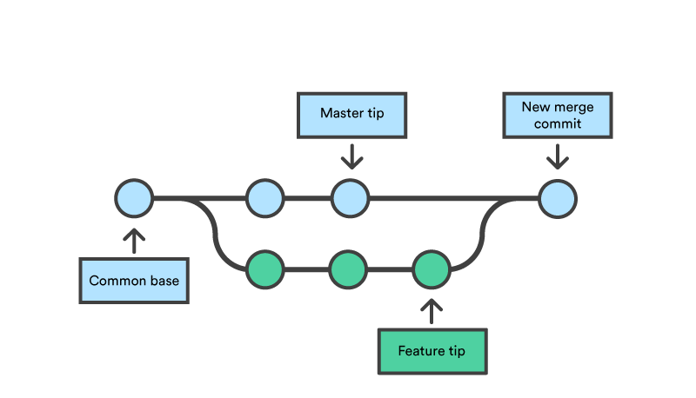
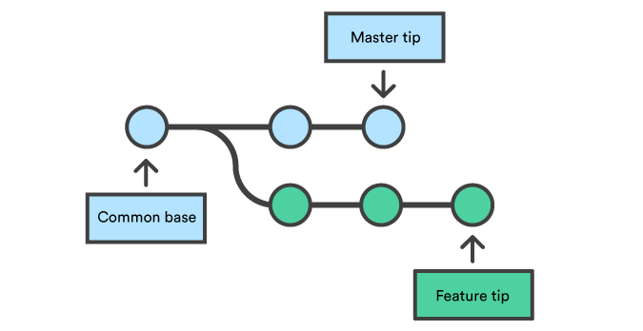
What is Merge in Git?
What is git Merge?
Merging is Git's way of putting a forked history back together again.
git merge command lets you take the independent lines of development created by git branch and integrate them into a single branch.
git merge will combine multiple sequences of commits into one unified history. In the most frequent use cases, git merge is used to combine two branches.

Slide 17
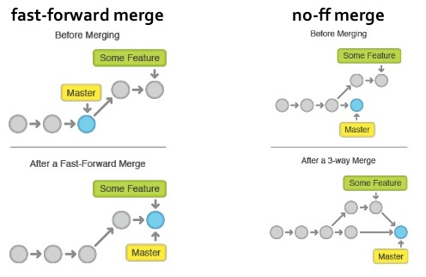
Fastforward Merge and Disabled Fast Forward Merge
What is Fast-Forward Merge and Fast forward merge disabled?

Slide 18
Fast Forward Merge Disabled
Fast Forward Merge disabled practice
Create new branch
Make changes to one file in this branch
Commit changes to git
Revert back to master branch
git merge newbranchName – no-ff → Commiting changes by disabling fast forward
Delete the branch
Using --no-ff allows someone reviewing history to clearly see the branch you checked out to work on.
Automatic Merge
Create a new branch
Modify files with some content in directory
Commit changes in the branch
Revert back to master branch
Make changes to another file while on master branch
Commit changes to master
git merge newBranchName –m “Merging changes from new branch”

Slide 19
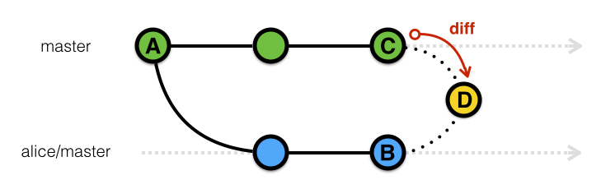
Merge Conflicts and Resolutions
Merge Conflicts and Resolution
Create new branch
Make changes to one file while on this branch
Commit changes to git
Revert back to master branch
Make changes to the same file on same location
Commit changes to master branch
Try merging the changes from the branch you created --> conflict will occur
Open the file and you will see the changes from both branches
Use git mergetool to resolve the conflicts
git commit –m “Done resolving conflicts”
Add .orig file in .gitignore file

Slide 20
Rebase in GIT
What is rebase?
Rebasing is the process of moving or combining a sequence of commits to a new base commit. Rebasing is most useful and easily visualized in the context of a feature branching workflow.
Rebasing is changing the base of your branch from one commit to another making it appear as if you'd created your branch from a different commit.
Git accomplishes this by creating new commits and applying them to the specified base. It's very important to understand that even though the branch looks the same, it's composed of entirely new commits.

Slide 21
Rebase in GIT
Rebase
Create new branch
Make changes to one file while on this branch
Commit changes to git
Revert back to master branch
Make changes to any file on same directory
Commit changes to master branch
Return to the branch you created
git rebase master → will copy the changes made to feature branch
git rebase –abort can be used to abort rebase
Make changes to the any file
git commit changes in the branch you created
Merge the branch you created to master branch

Slide 22
Rebase in GIT
Pull with Rebase
Stay on master branch
Make changes to any file in the directory
Commit changes to master branch
Go to github.com origin master repo and make changes to a file
git fetch origin master → this will update the references
git pull --rebase origin master → this will pull the latest changes from the origin master

Slide 23
Stashing
What is Stashing
Stashing takes the dirty state of your working directory — that is, your modified tracked files and staged changes — and saves it on a stack of unfinished changes that you can reapply at any time.
Stay on master branch
Make changes to any file in the directory
Get git status
git stash → allows you to make clean directory without committing changes and saves the state
Make changes to another file
Commit the changes
git stash apply → bring back the saved changes on another file
Commit the changes that were saved in stash
git stash list → lists the WIP stash
git stash drop → Drops WIP stash
git stash -u → Stashed untracked files in git / create new file and use this command
git stash pop → does git stash list and git stash drop commands together

Slide 24
Stashing
Muliple-Stash
git stash save “Name of the stash” → helps to distinguish in multiple stashes
git stash list --> lists all the stashes
git stash show stash@{1} → to show the changes for the stash reference
git stash apply stash@{1} → apply changes based on the stash reference
git stash drop stash@{1} → drops specific stash
git stash clear → drops all stashes
Branching when using stash
Make changes to a file on master branch
Stash the changes
git stash branch newbranch → applying stash on different branch

Slide 25
Homework
Research about what are tags in git
lightweight tags
Annotated tags
How to compare tags?
Updating tags
Remote tagging
What is Cherry Picking in GIT?
Create and example and explain to the class with commands

Slide 26
Q and A
Q and A????

